Slide 1
15 Minutes `til 50 Patients
MCI Response
Providence Little Company of Mary Medical Center Torrance
Torrance, California

Slide 2
Reflection
“Prepare for the unknown by studying how others in the past have coped with the unforeseeable and the unpredictable.”
General George S. Patton

Slide 3
Disaster Response Failures
Hospital Disaster Plan?
Unknown roles & tasks
Poor communications
Unclear patient pathways
Lack of relevant supplies
“That’s what it says, but that’s not what we do.”

Slide 4
Successful Solution
15 Minutes `til 50 Patients
Rapid Deployment
Designated Response
Tested/Vetted through over 30 Exercises Actual Events
Plug and Play Model
Implemented in 4 So Cal Hospitals

Slide 5
A Few Facts
Napa Earthquake-August 14, 2014
M 6.0
1 Death
200 injuries
Nisqually Earthquake-February 28, 2001
M 6.8
400 Injuries
Northridge Earthquake-January 17, 1984
M 6.7
57 Deaths
9000 injuries

Slide 6
Event Onset

Slide 7
Code TRIAGE Initiation
ED OFTEN HAS 1st INFO
- EMS radio call
- MAC/ReddiNet notification to ED
- Unusual surge of similar type patients presenting to Triage
CHARGE RN & MD
- evaluate needs & contact:
- House Supervisor/Admin On Call
House Supervisor/AOC:
- PBX for “Code Triage” overhead page

Slide 8
ED Actions 1st 15 Minutes
Roles assigned
Triage (Internal)closed
FT emptied into waiting room
Patients processed for discharge or admit
Floor RNs/CNAs come for immediate admissions
Consolidate remaining patients
Count of available beds to Disaster Lead
ED doors secured

Slide 9
Quick Reference ED
ED Notified via MAC/Reddi-Net
Notify House Supervisor via Phone/Pager/SpectraLink
House Supervisor MUST Initiate Code TRIAGE with PBX
ED Clinical Supervisor to Assign Staff for Response
ED to Establish External Treatment Area for Incidents involving Mass Casualties (on Loading Dock)
ED Staff (assigned by ED Clinical Supervisor) to Establish Minor Treatment Area in CHE
Don Personal Protective Equip
Color Coded Carts contain: Tarps/Canopies/Cots Located in Supply Shed On Loading Dock (Key to ALL Trailers & Storage in ED)
Additional Cots in Dialysis Room (in CHE*Code=5600)
ED to Clear Out Existing (Rapid Admission to be Completed by Units) Patients to be Ready to Receive “NEW” Victims
Turn On Hand Held Radio to Communicate Info/Needs to Hospital Incident Command Center
Update MAC and Incident Command as New Info is Received

Slide 10
Initiation Roles Assigned
Go-Kits in Radio Room
Loading Dock

Slide 11
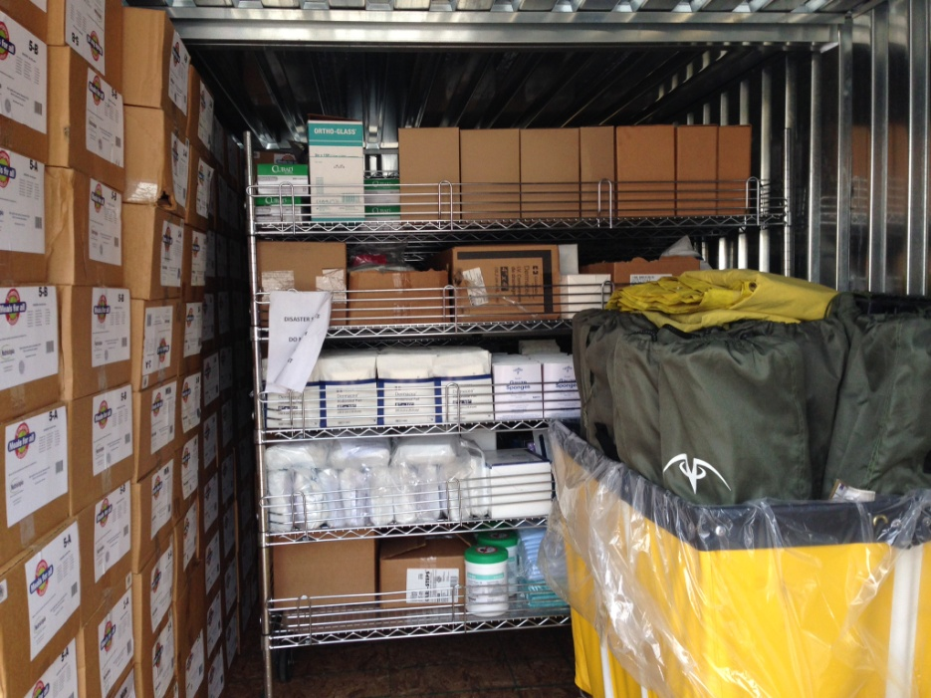
0-5 Minutes

Slide 12
5-10 Minutes
Immediate
Delayed

Slide 13
5-10 Minutes Public Safety
Access Control
Ambulance Drop-Off

Slide 14
Department of Public Safety
0-15 Minutes
Facility Lockdown
Access Control
As Patients Arrive
Traffic Control
Monitor Egress
Crowd Control
Ongoing/PD Assist

Slide 15
DPS
Deputize Staff/Volunteers
Post Up at Entry Points
Observe & Report
Evidence?
Cause of Event?
Maintain Chain of Custody

Slide 16
10-15 Minutes Assuming Responsibilities
Command Center
Disaster Communications

Slide 17
Set Up

Slide 18
15 Minutes

Slide 19
MCI Treatment Areas 1st 15 Minutes
10-20 Gurneys to staging
10-20 Wheelchairs to staging
Shower trailer moved & set up
Set up Cots
Set Up Canopies
Signs posted
Supply carts out
20 IV lines ready
20 O2 tanks ready
PPE donned
Treatment Area teams ready
Radio checks

Slide 20
Designated Response
Pharmacy
Radiology
Pre Stocked Med Carts
Deploy to
External Treatment Area
Loading Dock
Immediate/Delayed
Internal Treatment Area
Minor Treatment
Center for Health Educ.
Pharmacy Tech to ED
Pyxis in Bypass Mode
Deploy to Treatment Areas
C-Arm
Internal Treatment Area
Portable X-Ray
External Treatment Area
PACS Carts

Slide 21
Hospital Actions 1st 15 Minutes
Command Center Established
Coordinates resources
Equipment
Personnel
Patient flow into hospital departments
Ancillary support services
Communicates with
ED Disaster Lead directly
All Departments

Slide 22
ICU/Tele/Med-Surg 1st 15 Minutes
Safe Patient Hand-Off
Two RN’s from each unit report to ED Lead (one to transfer ED patients to unit-one to assist in patient care in ED
Facilitate Patient Flow
Set-Up

Slide 23
Meanwhile…
MCI Response is not just patient care centric.
Labor Pool established.
Unit Status Reports to HCC.

Slide 24
Facilities/Plant Operations 0-15 Minutes (& Beyond)
Immediate Facilities Structure Evaluation
Immediate Systems Check
(True Assessment=1.5-2 hrs)
Check Structural Integrity
Report Findings to HCC
Operations Section Chief
Deputize On-Site Construction Personnel to Assist

Slide 25
POM Code TRIAGE Assessment

Slide 26
Facilities/POM Understanding Capabilities

Slide 27
Facilities/POM What next?
Assist with Decontamination
Assist with Infection Control
Assist with Patient Transport
Assist as Runners
Ensure Utilities are Viable

Slide 28
ED Actions Role Assignments
Disaster Lead – RN
ED Charge – RN
Set Up & Decon – Techs/CCTs
Triage - RN
Immediate Team
2RNs + MD + Reg + RT
Delayed Team
2RNs + MD + Reg + RT

Slide 29
Waiting for Patients

Slide 30
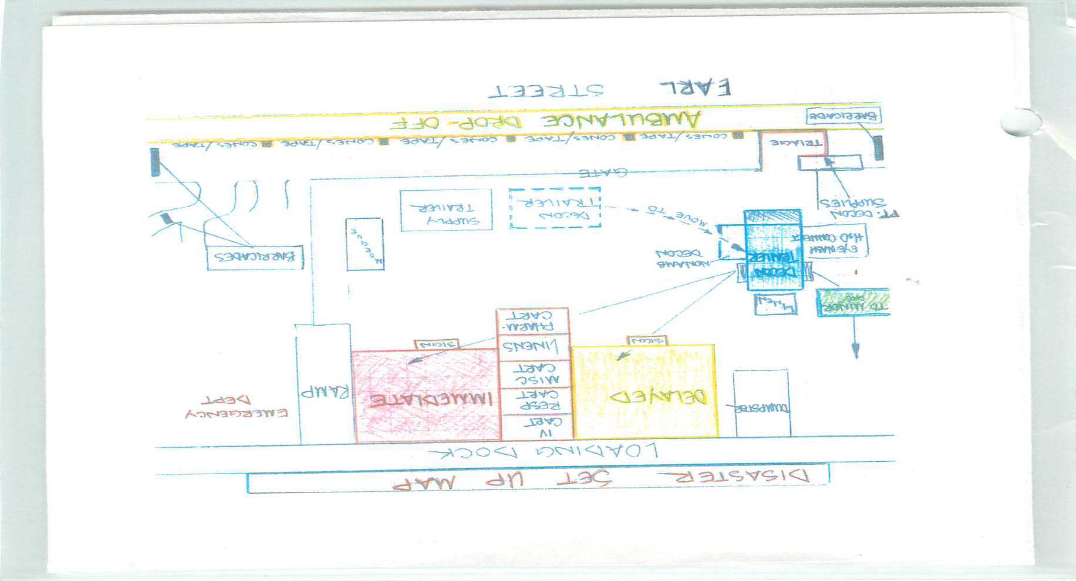
Ground Floor/Set Up Map Vests

Slide 31
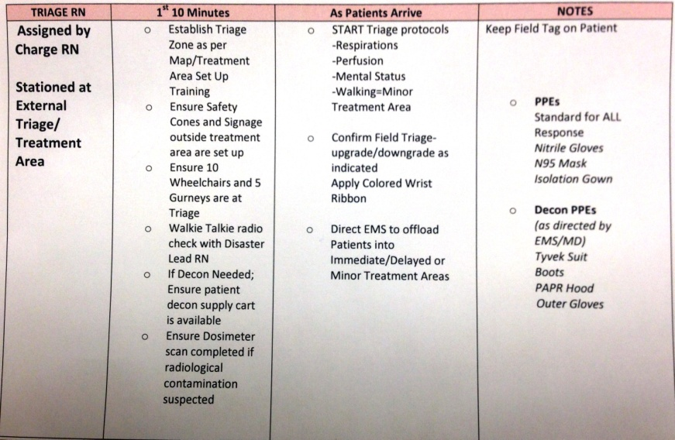
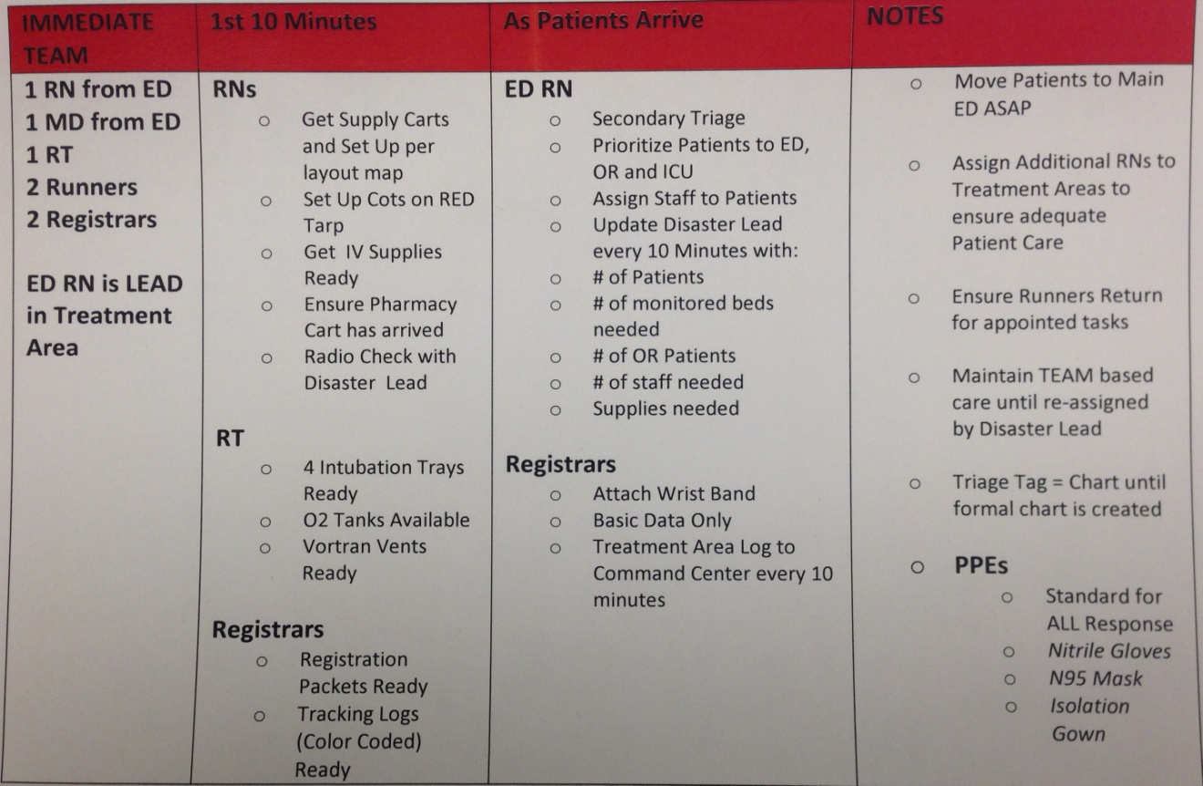
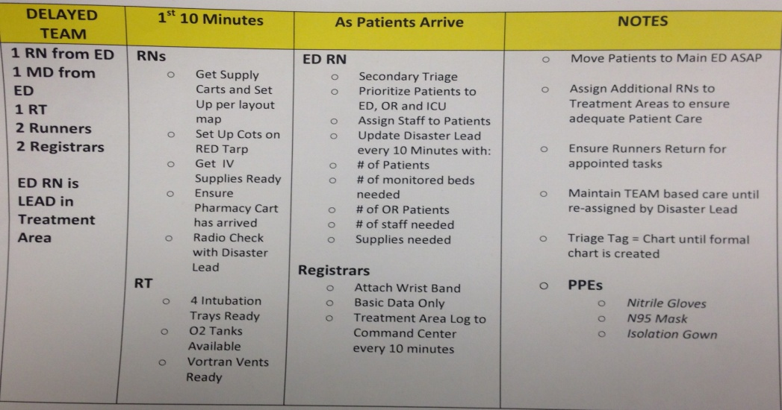
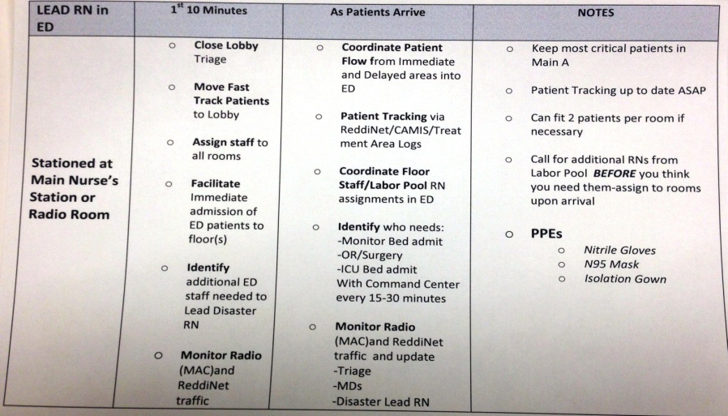
Job Action Cards Vests

Slide 32
Standing Med Orders Vests

Slide 33
Floor Units

Slide 34
TRIAGE As Victims Arrive
5-10 second evaluation (START/JumpSTART)
Respirations
Perfusion
Mental Status
Injury Extent
Confirm or change EMS triage status
Put on colored tag/ribbon on patient
Red = Immediate
Yellow = Delayed
Green = Minor
Black = Expectant/Expired
Direct to pathway for appropriate care

Slide 35
Triage (External)

Slide 36
Treatment Area Teams As Victims Arrive
RNs + MD + Resp + Registration
ABC (CAB) level of care + standing orders
Labs drawn while IV started
Triage tag & Assigned packet = medical record
Triage within care areas for victim movement
Critical care/OR/Tele/x-ray/ED/ etc
Update lead every 10 minutes

Slide 37
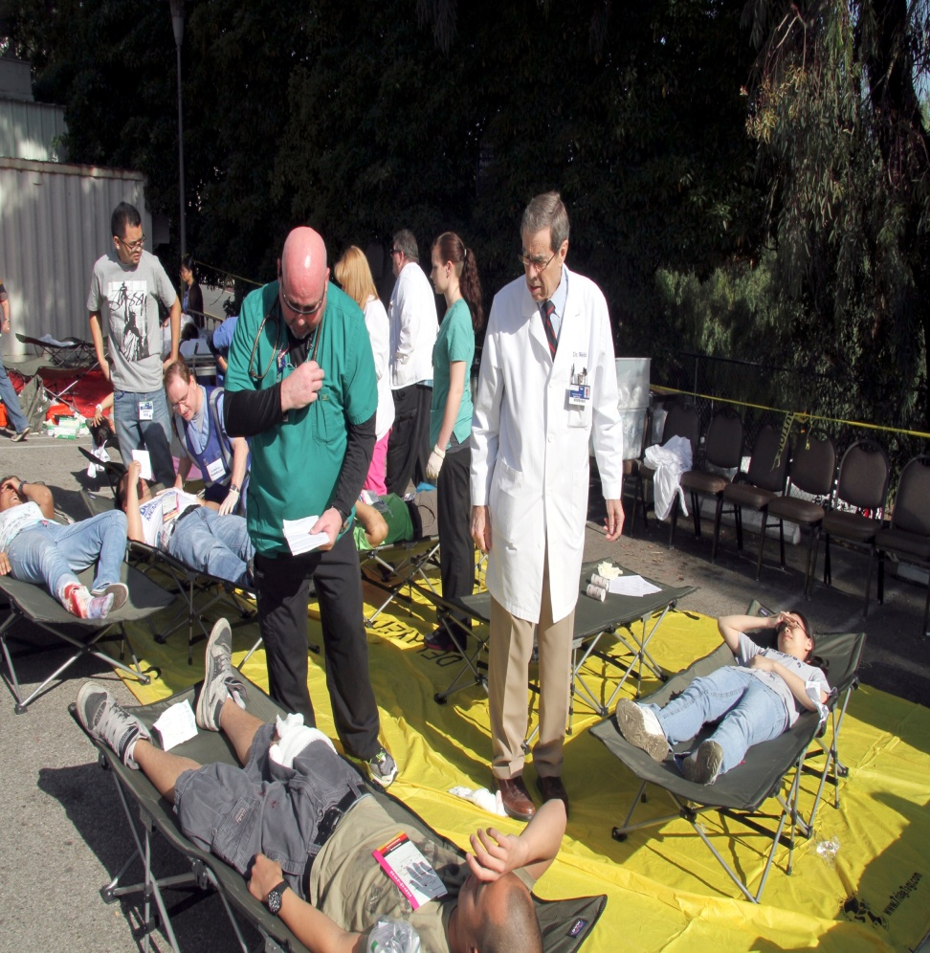
Treatment Area(s)
PLCMMC Torrance
PLCMMC San Pedro

Slide 38
Patient Care

Slide 39
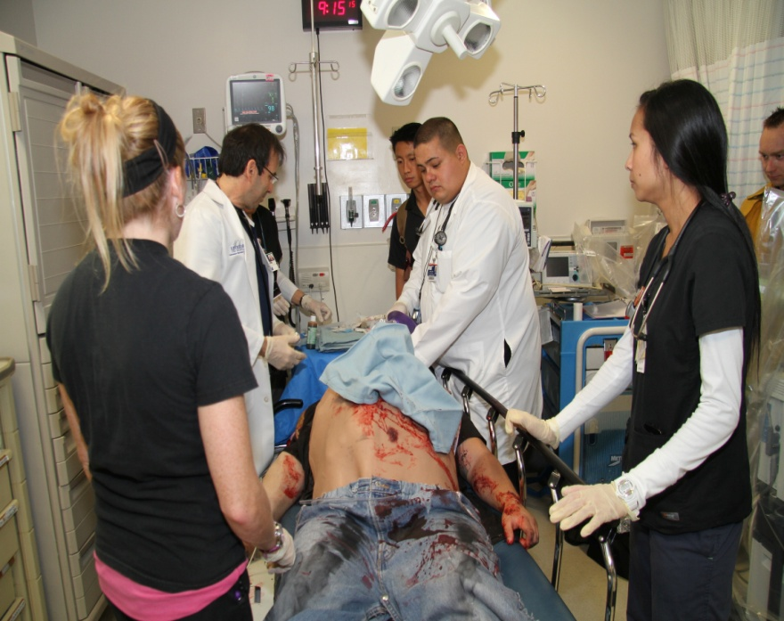
What about the ED…?

Slide 40
Patient Flow…
Triage all the time everywhere
Immediate first, then Delayed
Common sense!!!
Anticipate needs
Equipment
Personnel
Movement

Slide 41
Critical Elements
A-B-C (C-A-B) level of care until hospital can accommodate
Patient flow does not change even if location does
1st 15 minutes of response sets stage for entire response
Roles stay in assigned areas
Lab/X-ray results stay with patient

Slide 42
Transitioning into Disaster Mode
Easy if you are prepared…
Disaster Planning/Training
Disaster Exercises
Hospital Layout
Common Sense
Do the best you can under the circumstances!

Slide 43
Disaster Mode…Simplified
Comes down to TWO key components:
Patient CARE
Patient FLOW

Slide 44
Putting It All Together
Time Lapse Video from Full Scale Exercise 4/9/2015

Slide 45
Thank You for the Opportunity

Slide 46
Contact Info
Chris Riccardi, CHSP,CHEP
Emergency Management Officer
Disaster Preparedness and Project Coordinator
Providence Little Company of Mary Medical Center Torrance
o-310-303-5551
e-christopher.riccardi@providence.org

